Slide 1
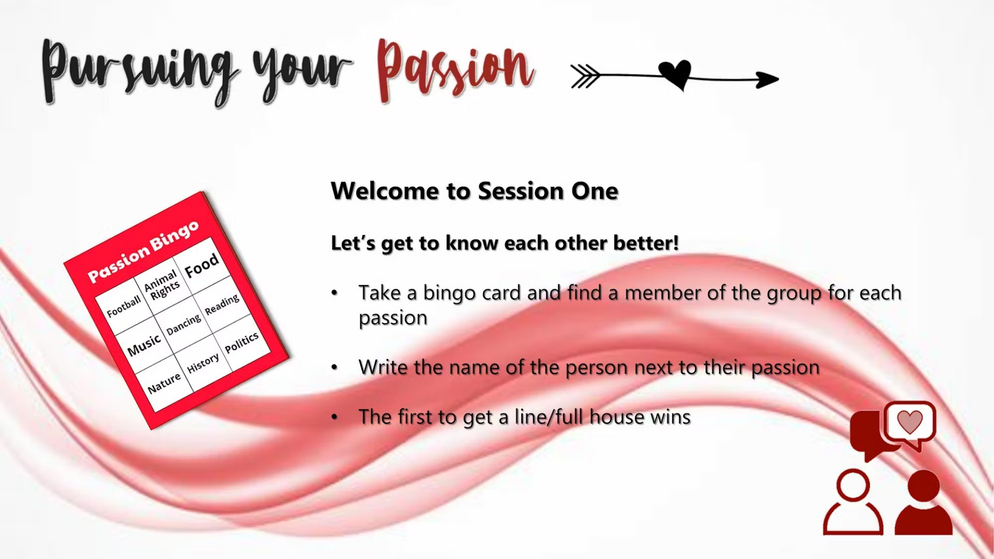

Slide 2


Slide 3


Slide 4


Slide 5


Slide 6
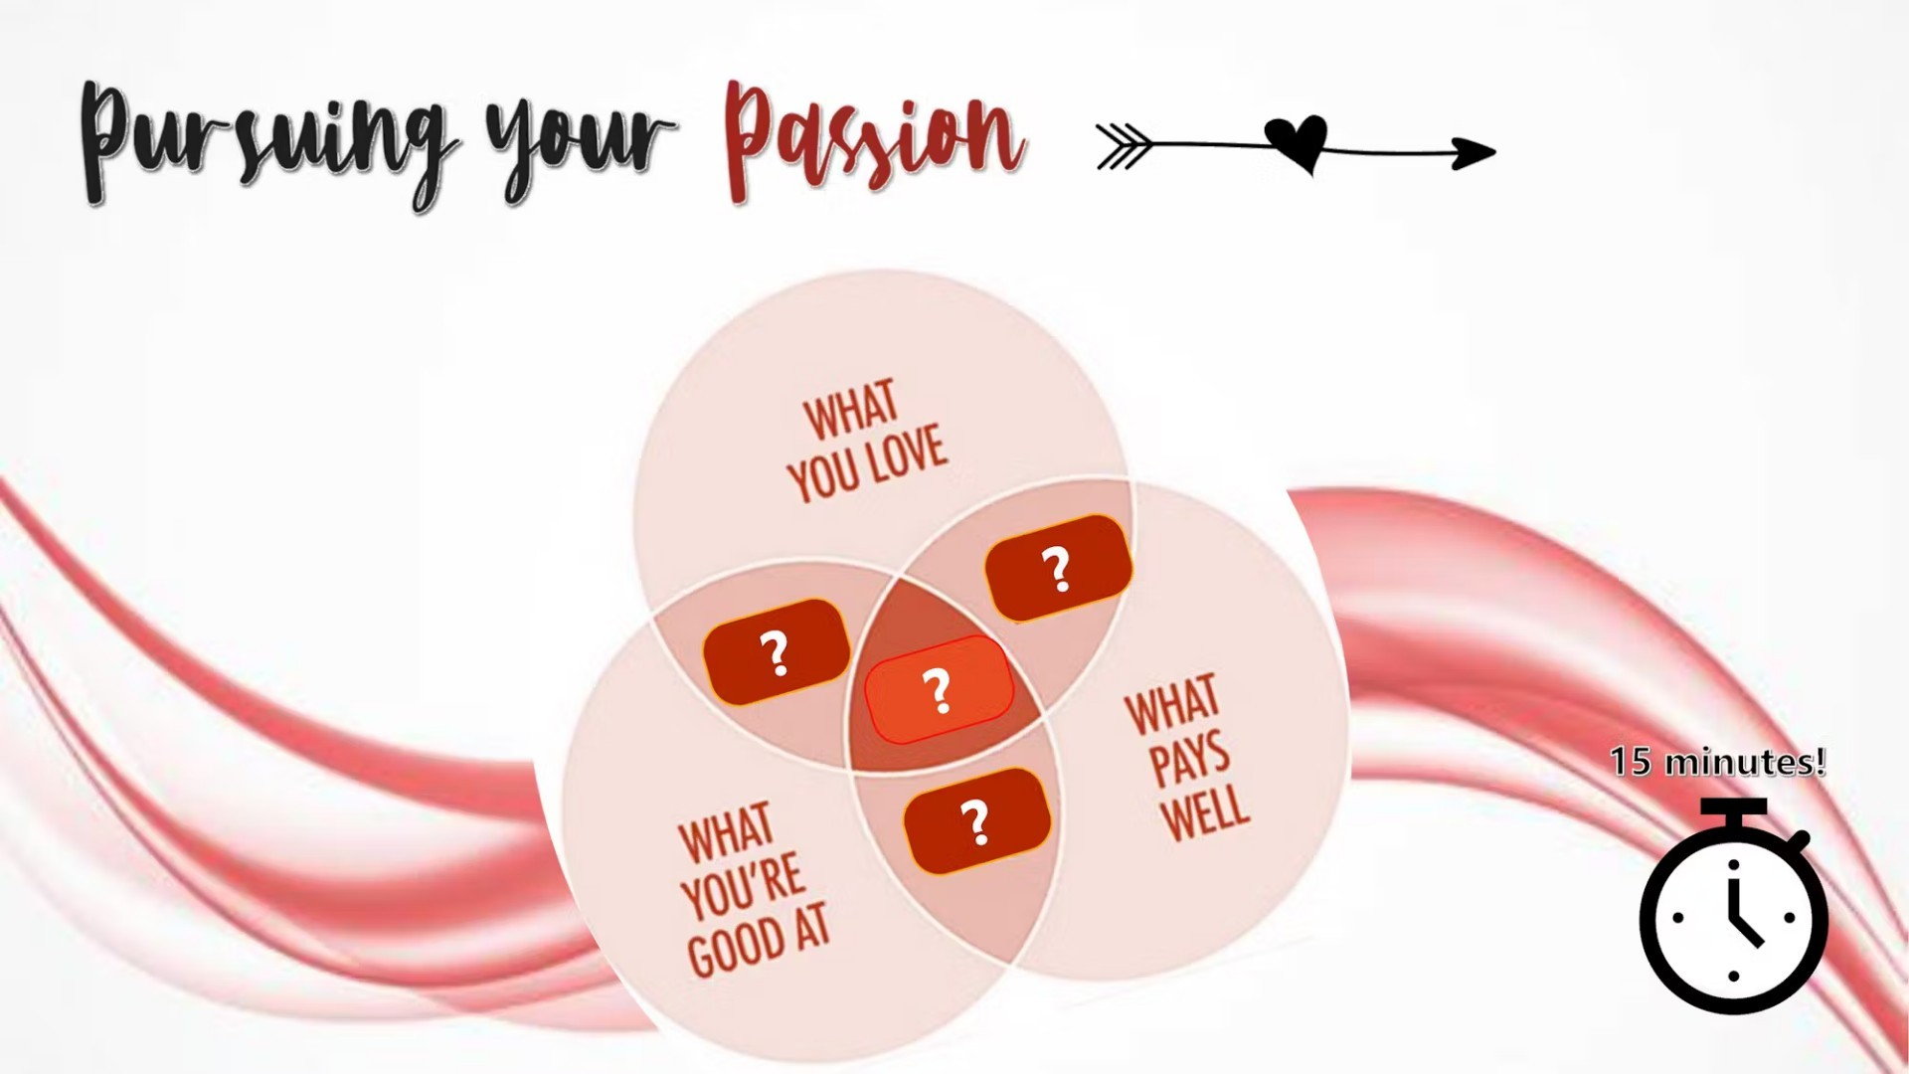

Slide 7

What is your Dream Job?

Slide 8


Slide 9


Slide 10
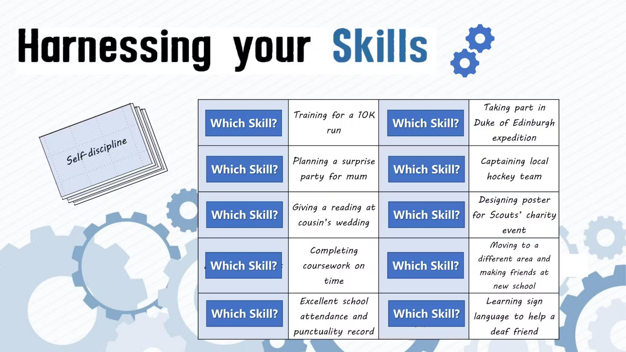

Slide 11


Slide 12


Slide 13


Slide 14

What does “fall forward” mean?
What is the “gift of long suffering”?

Slide 15
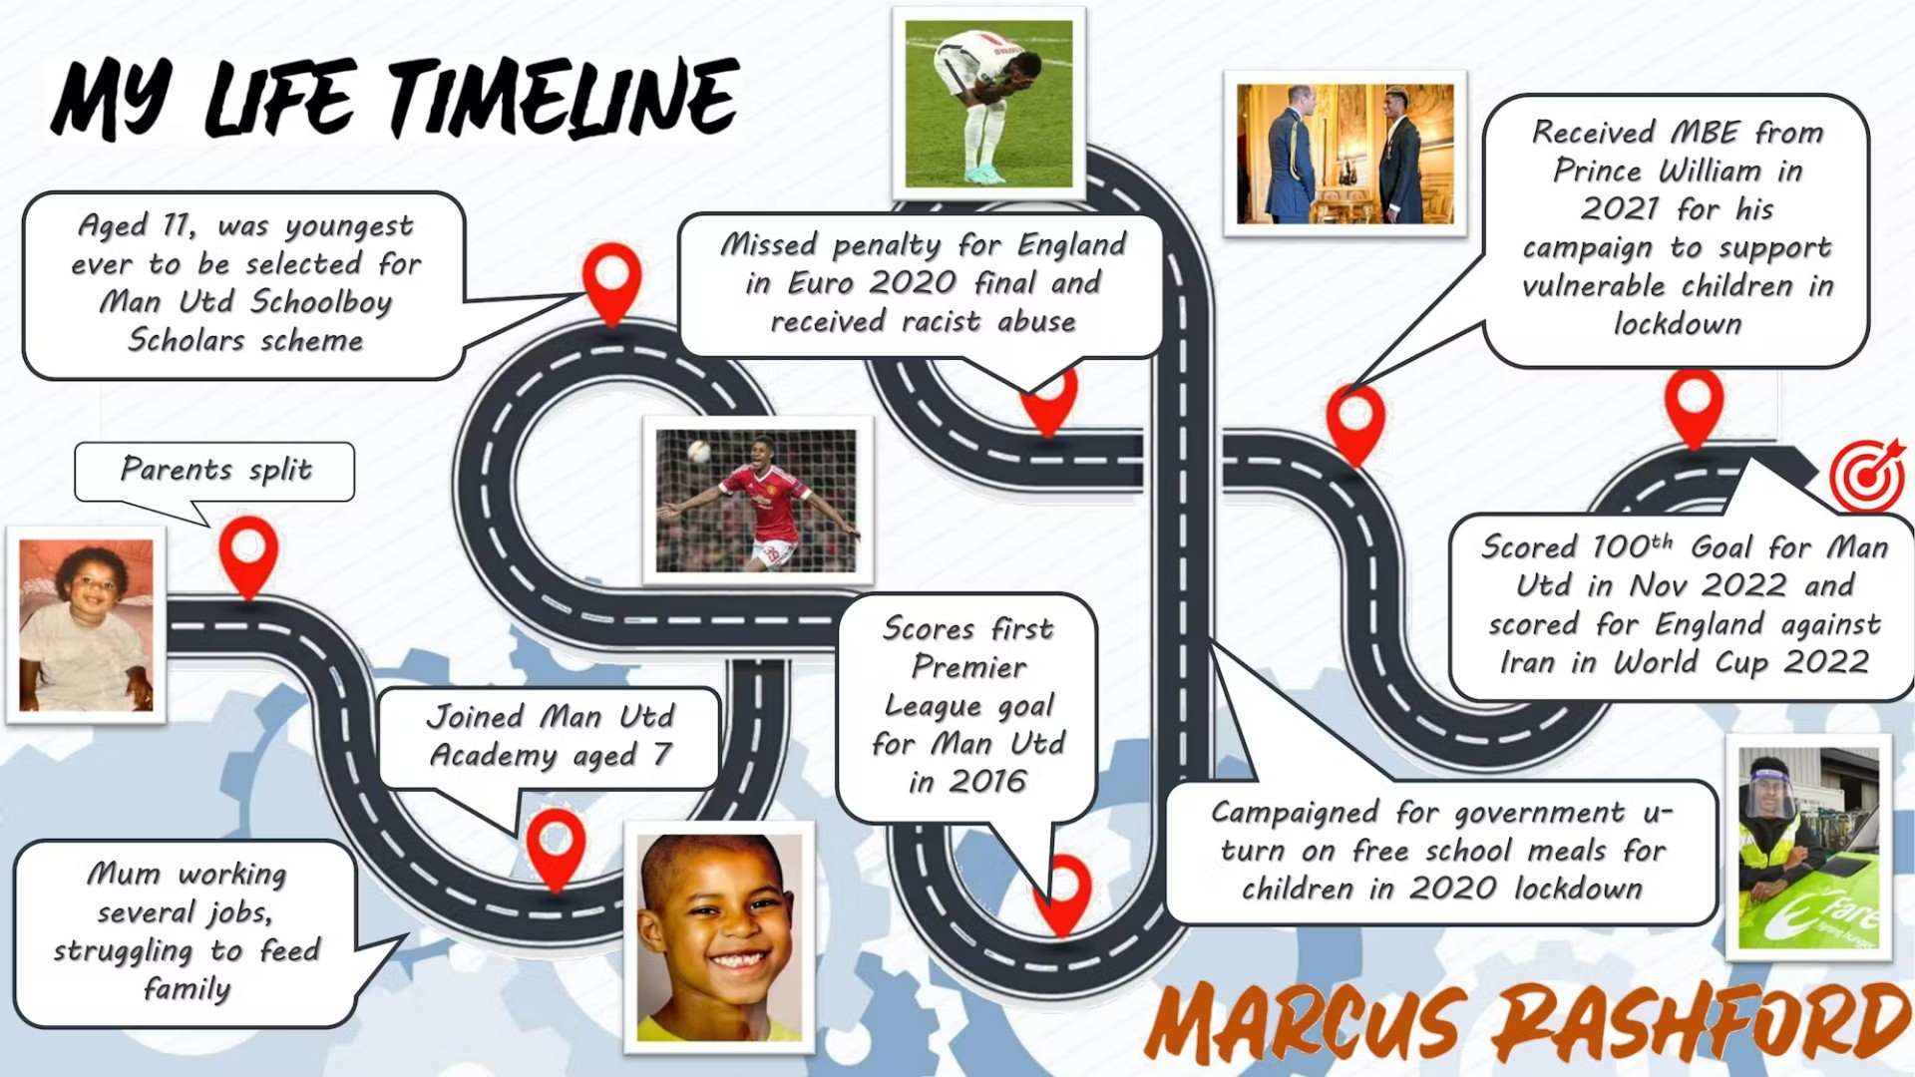

Slide 16
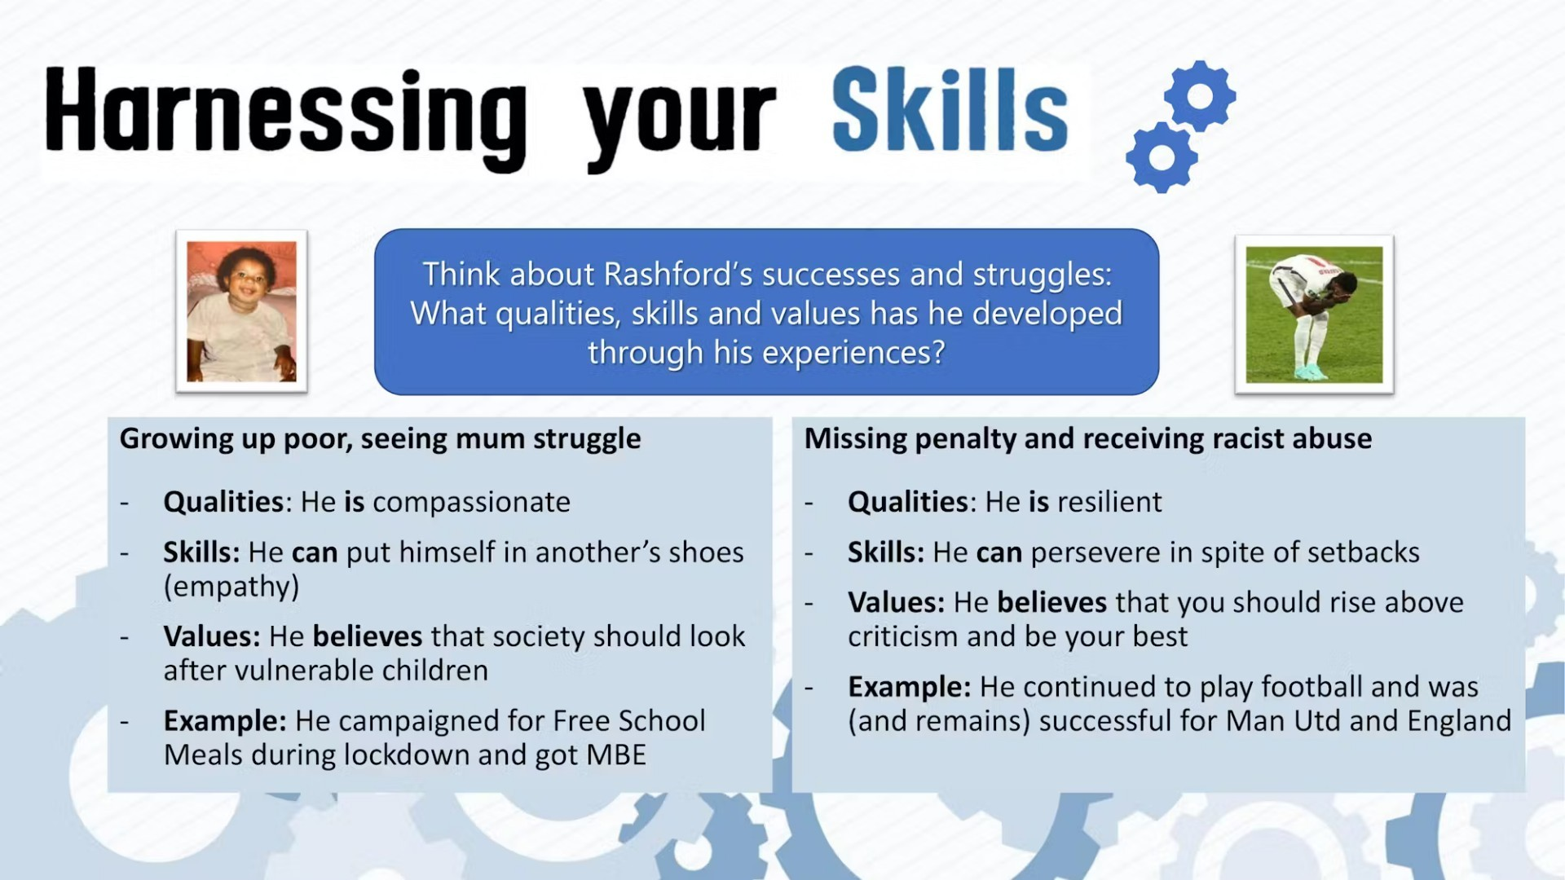

Slide 17
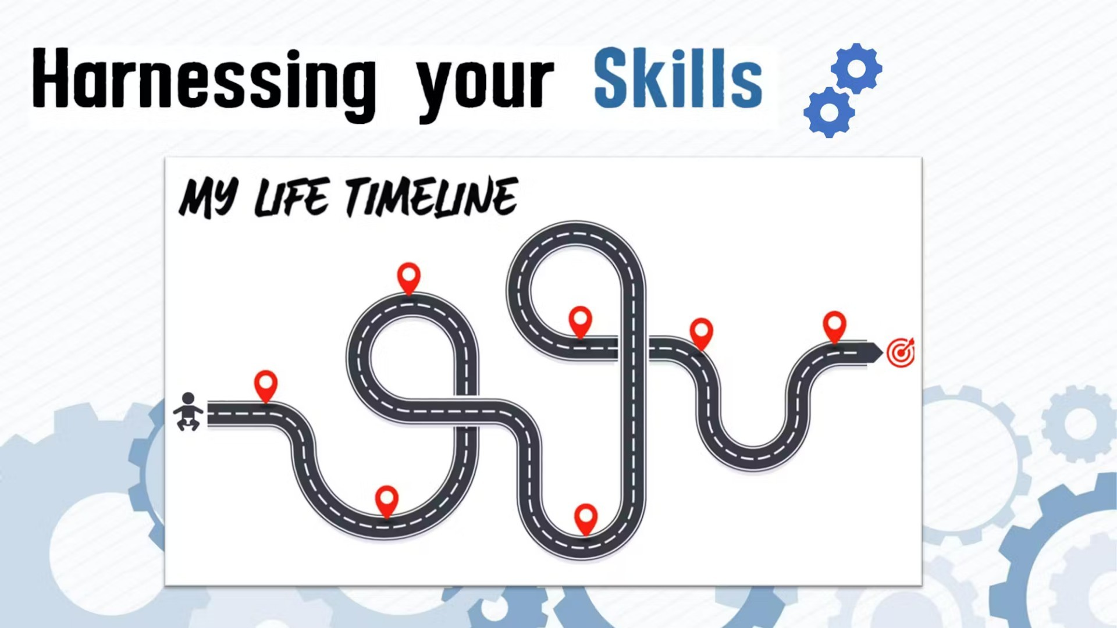

Slide 18
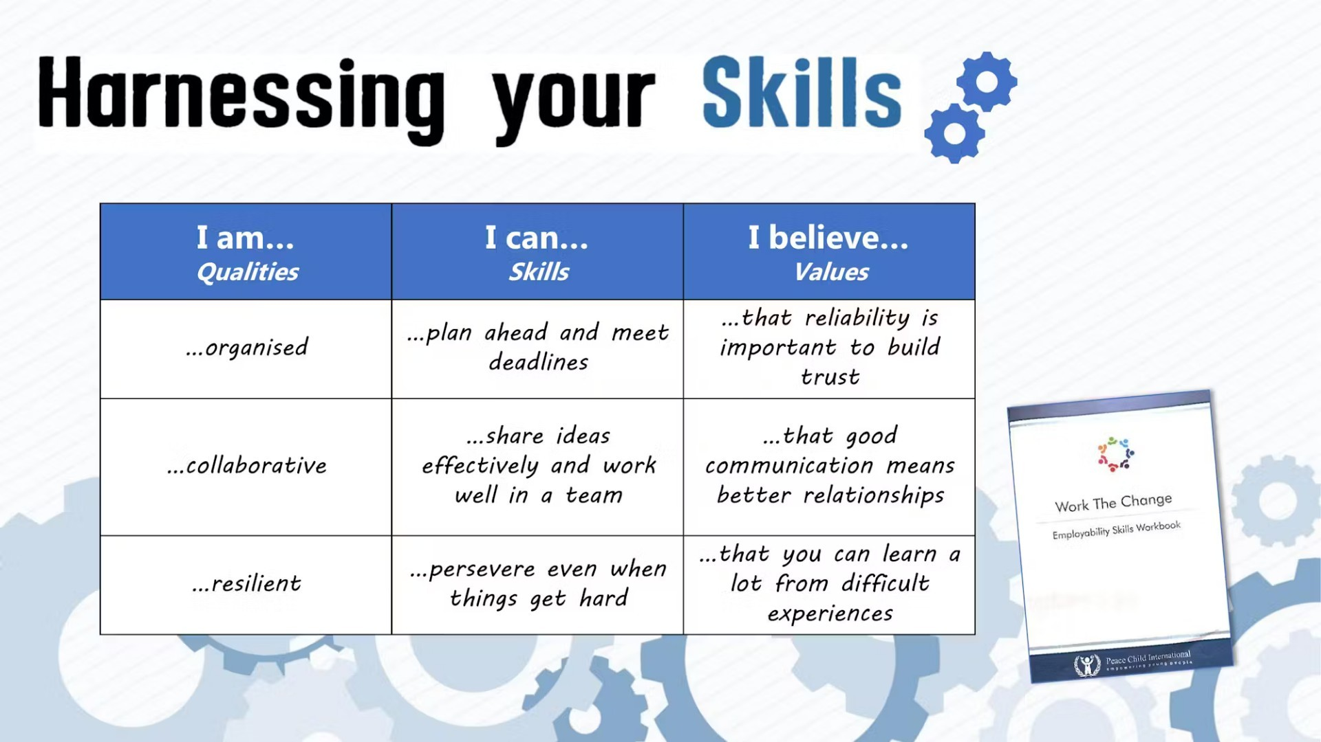

Slide 19


Slide 20



Slide 21


What Does CV Mean?

Slide 22
What is a Personal Statement?

Slide 23


Slide 24
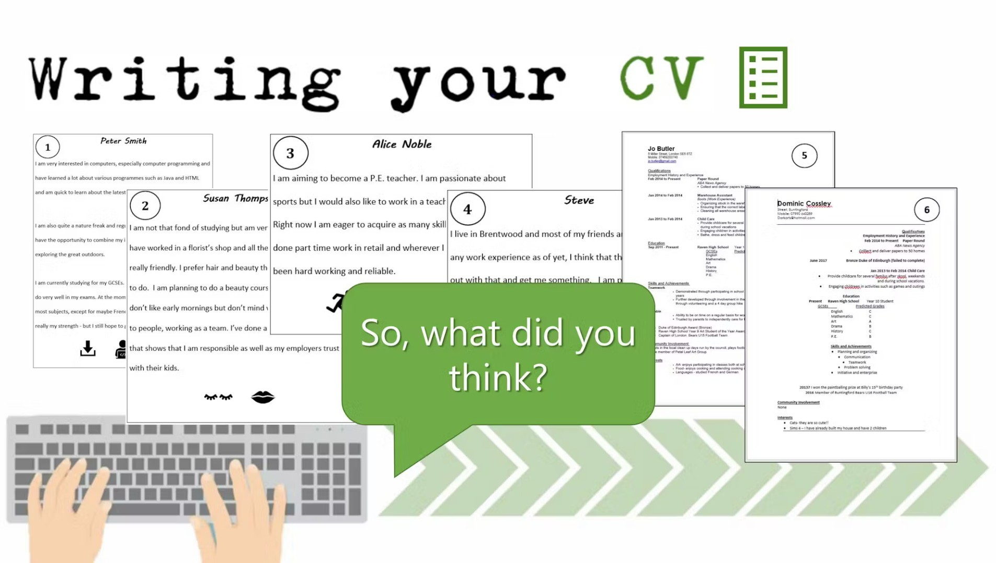

Slide 25
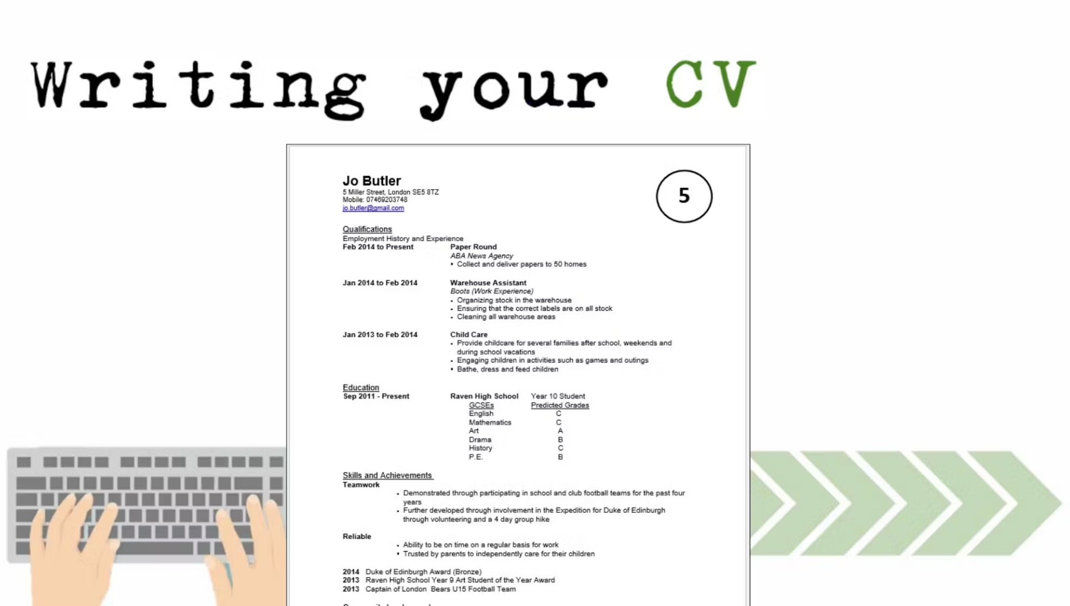

Slide 26

Alice Noble
I am aiming to become a P.E. teacher. I am passionate about sports but I would also like to work in a teaching environment. Right now I am eager to acquire as many skills as I can. I have done part time work in retail and wherever I work I have always been hard working and reliable.

Slide 27
A good CV won’t guarantee a good job but it could help you get…
A discussion
An interview
A trial period
A good reputation

Slide 28
A good CV won’t guarantee a good job but it could help you get…
A discussion
An interview
A trial period
A good reputation

Slide 29
A good CV should include as much information as possible.
True or False?
False: you should only include certain information
False: you should include as little information as possible
True: that’s exactly what a CV is for

Slide 30
A good CV should include as much information as possible.
True or False?
False: you should only include certain information
False: you should include as little information as possible
True: that’s exactly what a CV is for

Slide 31
How long on average does it take for a recruiter to make a decision on a CV?
10-15 seconds
1-2.5 mins
4-6 mins
10 mins

Slide 32
How long on average does it take for a recruiter to make a decision on a CV?
10-15 seconds
1-2.5 mins
4-6 mins
10 mins

Slide 33
How many people don’t know how to write a CV correctly?
4/10
6/10
8/10

Slide 34
How many people don’t know how to write a CV correctly?
4/10
6/10
8/10

Slide 35

Brainstorm!
So what do you need to consider when writing a CV?

Slide 36
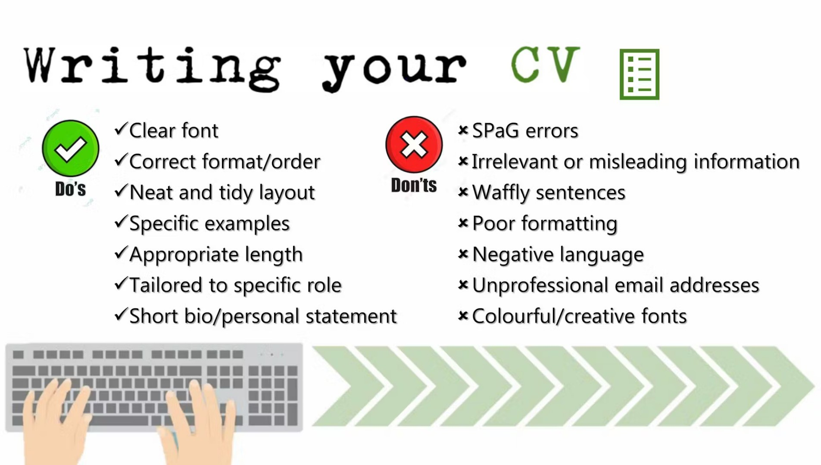

Slide 37


Slide 38


Slide 39



How confident do you feel now about writing a Personal Statement/CV?

